Slide 1
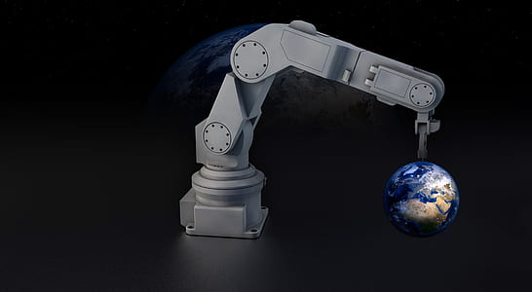

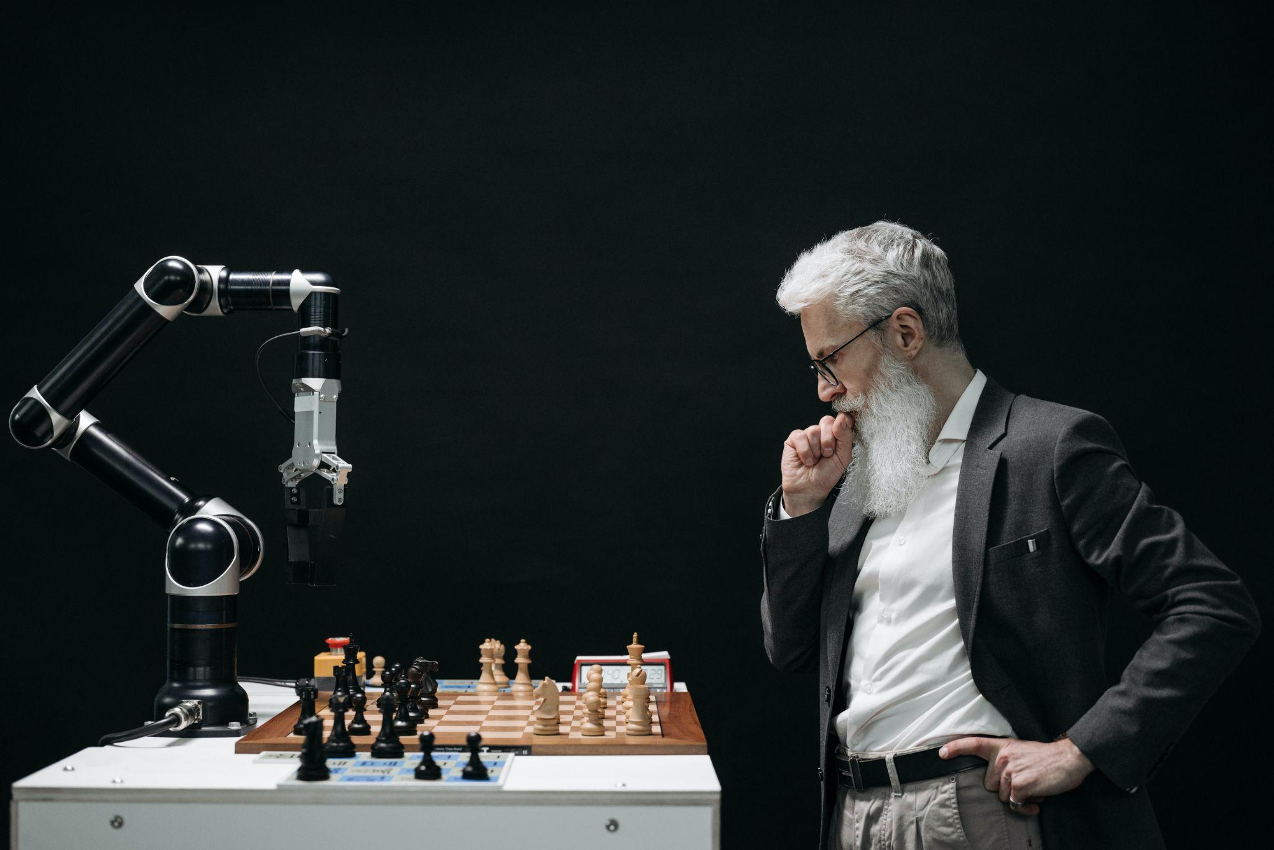

Visual Servoing Project
SUPERVISED BY
PROFESSOR OMAR TAHRI
SAMUEL IJEOMA BONIFACE
MISHECK EMMANUEL CHIRWA
14 December 2022
‹#›

Slide 2
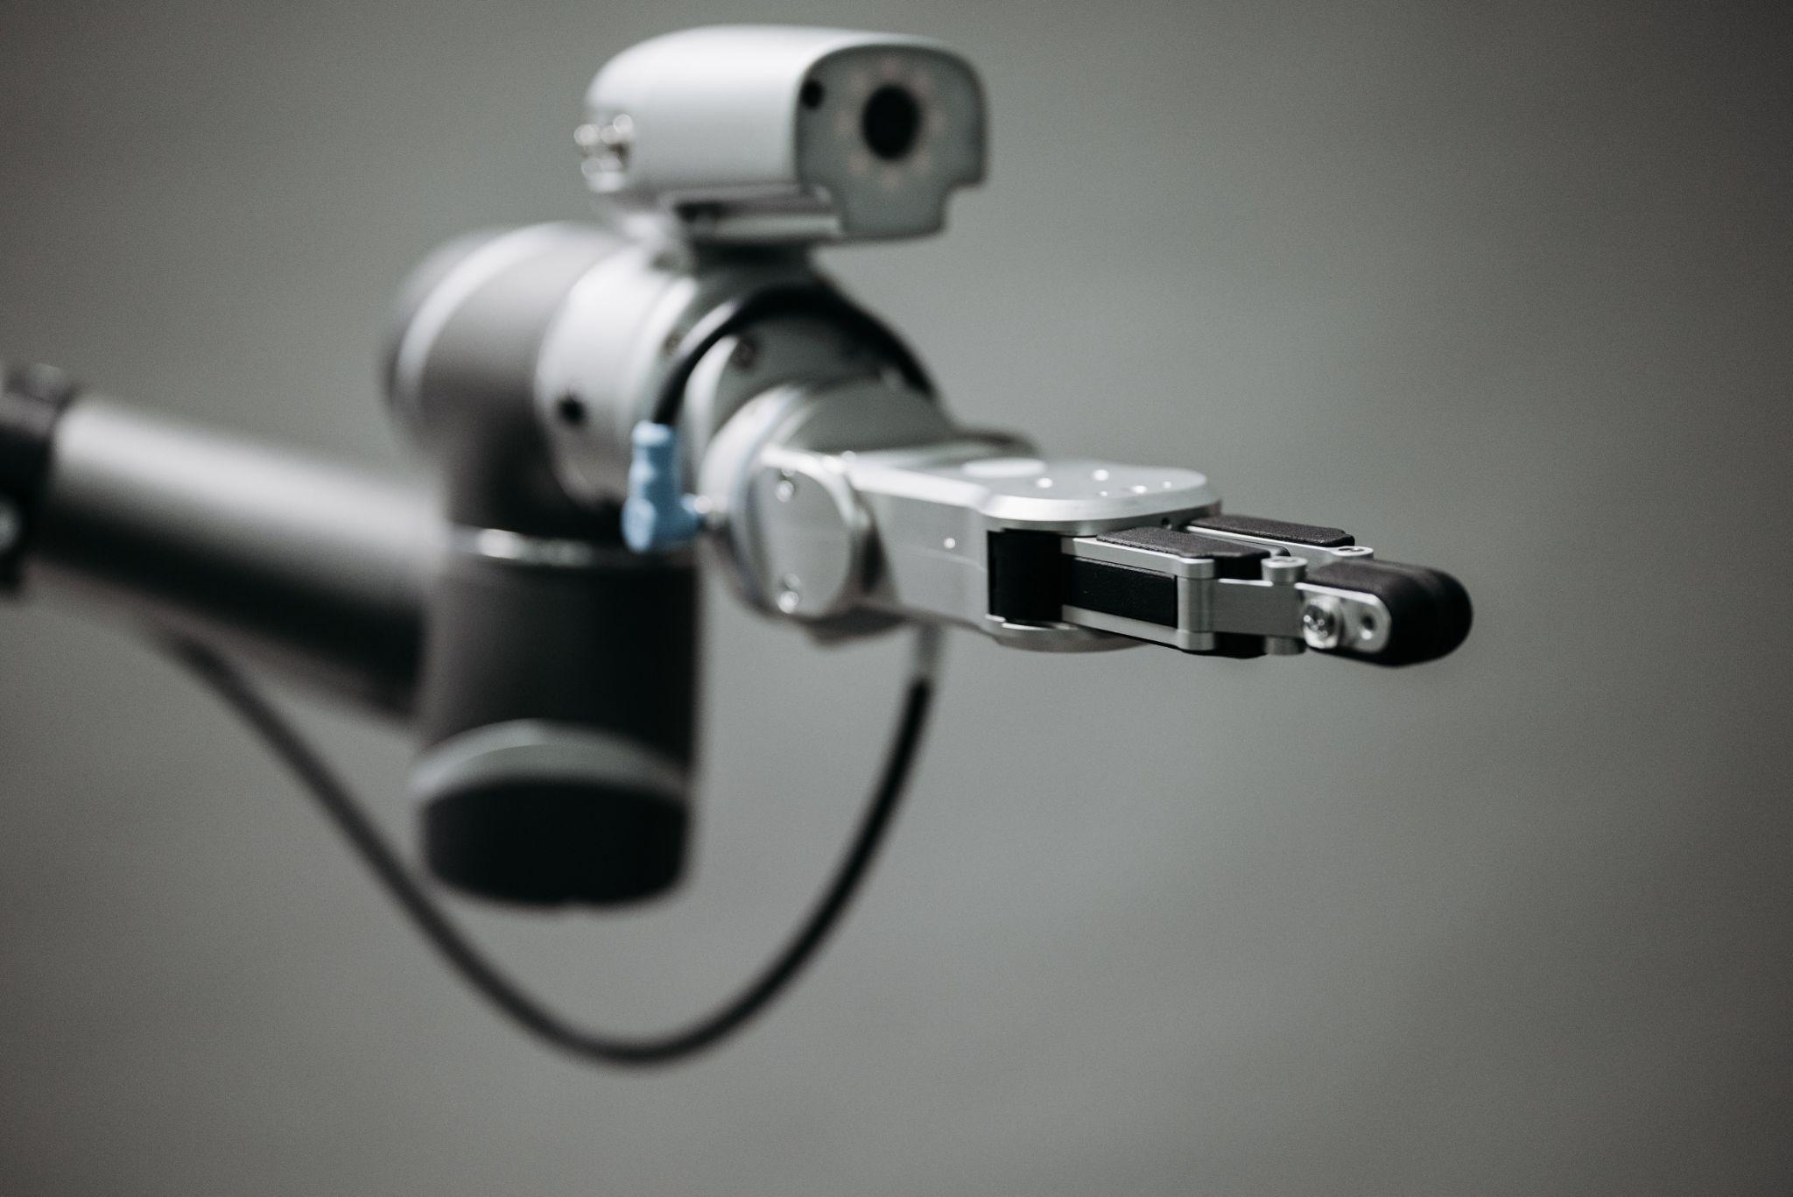
Outline
Introduction
Work-Flow
Implementation
Demo
Conclusion

Slide 3



Introduction
This project used ROS to demonstrate a simple line following Turtlebot3 in both Gazebo and real environment using Ubuntu 20.04, ROS Noetic and OpenCV 3
The Turtlebot3 is used as the vehicle to demonstrate the concept which uses simple Image Processing Techniques
The main decider of the robot’s trajectories is the camera looking parallel at the robot and the target position.

Slide 4
Work-Flow
01
02
Camera Calibration is the first phase of the project
Image Detection is the first phase of the project
The purpose of this project is to implement an end-to-end visual servoing project using a wide angle camera and a Turtlubot3 with ROS. ​
03
04
Pose Estimation to estimate the current and target pose
Robot Navigation to move the robot to the target pose

Slide 5
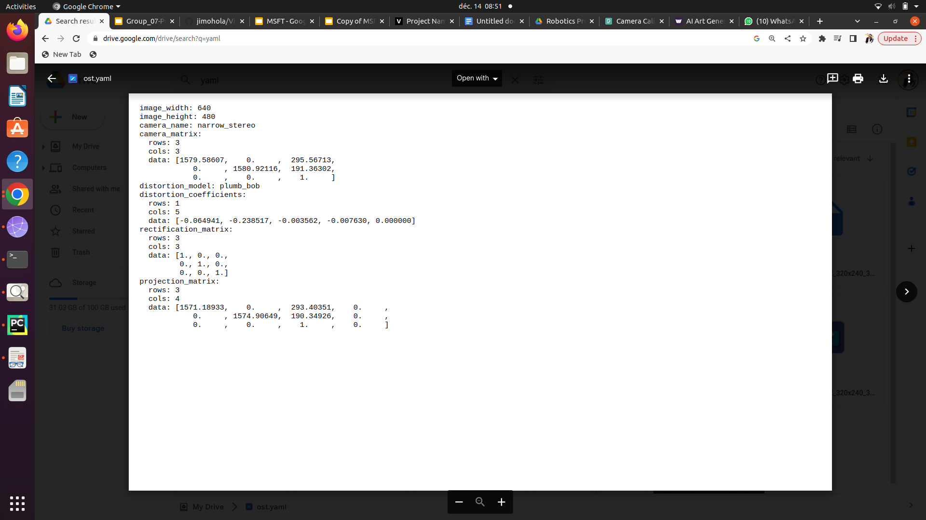
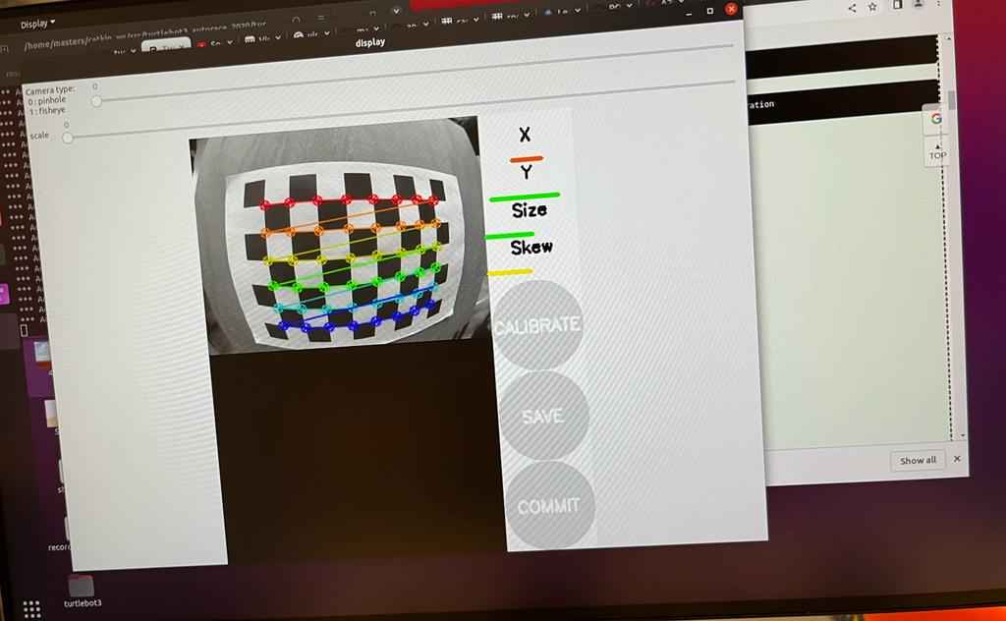
Camera Calibration
We used the ROS camera calibration package for calibration of our monocular camera using a checkerboard calibration target.
we calibrated the camera using a checkerboard to obtain the camera intrinsic and extrinsic parameters with distortion coefficients.
The command as such, rosrun camera_calibration cameracalibrator.py --size 8x6 --square 0.08 image:=/camera/image_raw camera:=/camera

Slide 6
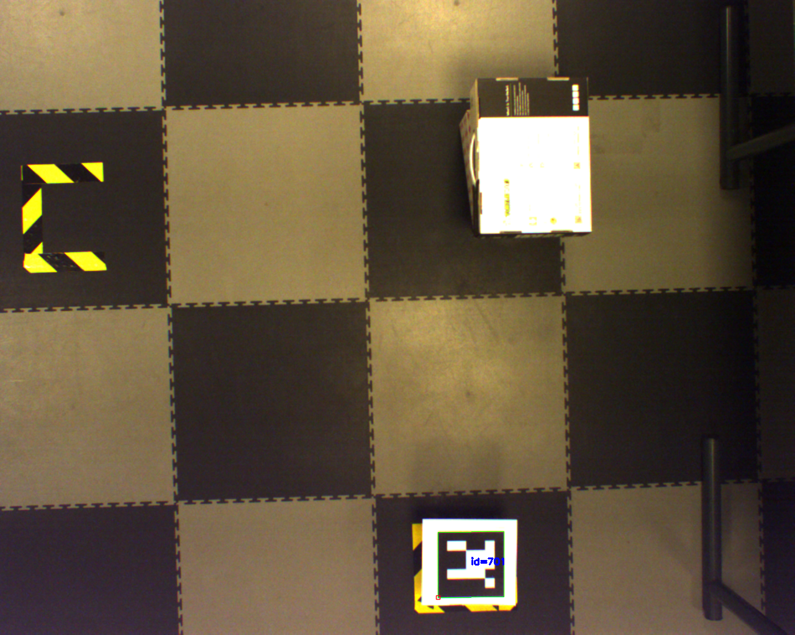
Image Detection
we used the fisheye camera to acquire real time image by subscribing to the ROS topic "/camera/image_raw".
The image was saved as goal_pose.png.
We then used the distortion coefficients acquired from the camera calibration stage to undistort the image.

Slide 7
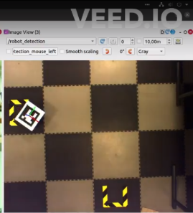
Pose Estimation
We used the OpenCV library to detect the Aruco marker placed at the top of our turtlebot3 to get the target pose by calling its function cv2.detectMarkers
we call the function aruco.estimatePose Single Markers in order to get the translational vector [x, y, z] and rotational vector [x, y, z]
The controller will subscribe to get the vectors as ROS topics, current_position and target_position

Slide 8
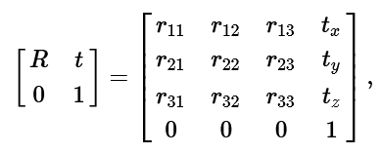
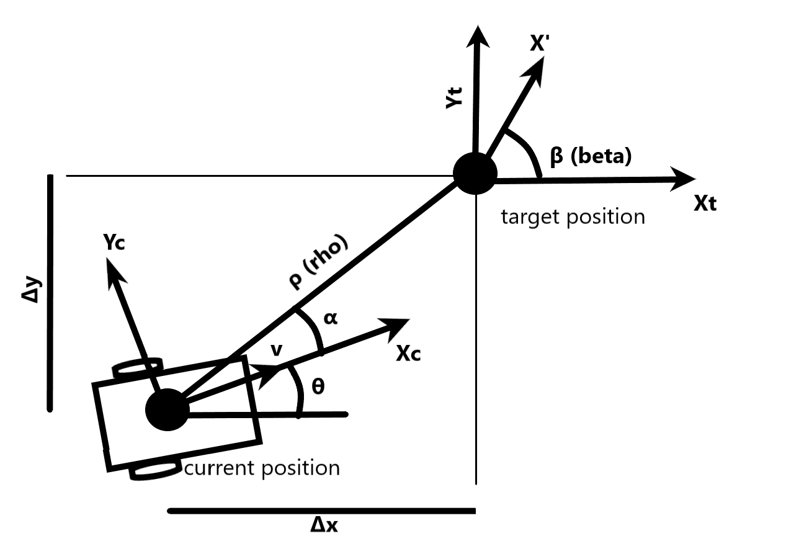
Robot Navigation
Convert rotational and translational vectors to homogeneous matrices
Calculate the α angle and distance ρ between current and target positions
Calculate the alpha angle between the current and target positions by taking the inverse tangent (arctangent) of the displacement vector:
alpha = atan2(y2 - y1, x2 - x1)
These calculations will provide the alpha angle and distance rho between the current and target positions, which can be used to guide the movement of an object in two-dimensional space

Slide 9
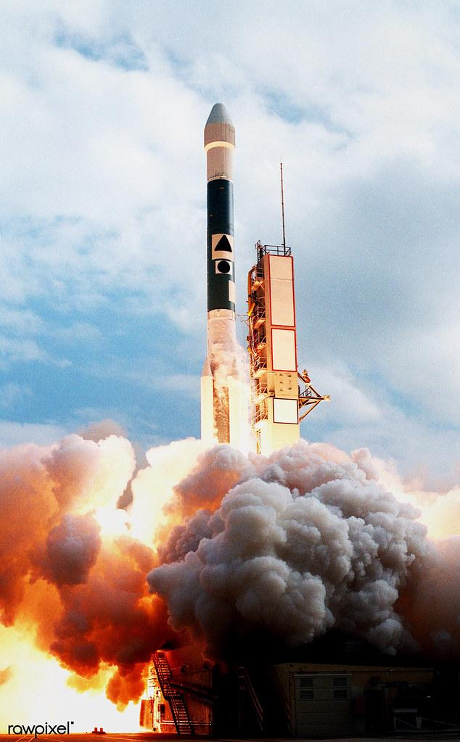
Demo
Execute Roscore:
>roscore
Launch the camera:
>roslaunch ueye_cam rgb8.launch
Remote monitor and control:
>ssh ubuntu@192.168.0.200
On the turtlebot run:
>roslaunch turtlebot3_bringup turtlebot3_robot.launch
On the remote computer:
>rosrun my_aruco_tracker pose-estimation.py

Slide 10


Slide 11
Limitations
The major limitation that we faced was the environmental aspect of how light was being projected into our environment were we carried out our experiments.
From my point of view, the camera’s field of view is something that plays a huge role as its responsible for what the above view camera see’s if the camera isn't properly positioned, you will tend to have misleads for example caption of the aruco marker.

Slide 12
Conclusions
We would like to conclude bringing to notice the project was indeed challenging but worths all time and attention given to it.
Time was a huge factor on our hand as with more experimental, we would have gotten a lot more to reach the experiments full extent.

Slide 13


